Slide 1
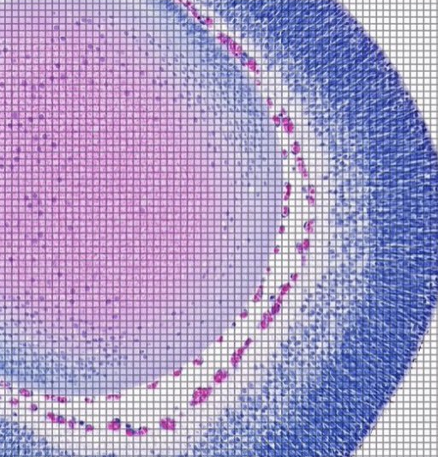

Gene Expression in Alzheimer’s Disease Patients
Groups of Interest:
Moderate vs Incipient
Severe vs Moderate
Notes:
Proposed path to future state
Align story with respect to https://www.mckinsey.com/business-functions/mckinsey-analytics/our-insights/breaking-away-the-secrets-to-scaling-analytics https://www.mckinsey.com/business-functions/mckinsey-analytics/our-insights/the-executives-ai-playbook?page=value/

Slide 2

Agenda
Introduction to Alzheimer’s Disease
Moderate vs Incipient Group Analysis
4 pathways of interest
Severe vs. Moderate Group Analysis
Observations against the same 4 pathways of interest
Questions
Notes:
1 week

Slide 3
Introduction to Alzheimer’s Disease (AD)
Common Symptoms
Biological Changes
Need for Research
Current knowledge suggests tau proteins accumulate in memory-centers of the brain
Beta-amyloid proteins clump between neurons
Eventually the neurons begin to die
There is no known cause or treatment for AD
The use of genetic data could help determine a cause or treatment
Memory loss
Cognitive difficulties
Mood swings

Slide 4
Moderate vs. Incipient

Slide 5
Estrogen Receptor Pathway
How does it function normally?
Estrogen receptors bind to estrogen, a female sex hormone, and initiate a multitude of physiological responses.
This includes protein synthesis that affects the cardiovascular system, liver, brain, and more.
Estrogen has a “protective effect” on neurons, emotion, and inflammation in the brain
How does it relate to Alzheimer’s Disease?
Post-menopausal women have a significantly higher chance of developing AD due to the sharp decline in estrogen in their bodies
Almost ⅔ of diagnosed AD patients are women
Research shows estrogen can reduce the release of beta amyloid proteins
Moderate Alzheimer’s patients had 2 genes significantly less expressed in this pathway compared to incipient patients
JUN (transcription factor) and PPARA (regulates an enzyme that produces beta-amyloid)
Both have a negative fold change and p < 0.001

Slide 6
Enrichment Analysis Findings for Insulin Resistance
Let’s focus on this first
Comparing Severe vs Moderate Groups
We see 17 occurrences of different pathways that regulate insulin production, secretion and resistance
3 of those with p-values < 0.05
Most highlight the insulin release controlled by glucagon-like peptide-1 in intestines
Comparing Moderate vs Incipient Groups
Insulin resistance is a significant pathway with
0.01 p-value
4/108 overlap
Linked Genes:
SLC27A6 | PPARA | PRKAG3 | MTOR
Linked Genes:
PRKAR2A | RAPGEF4 | DOK1

Slide 7




Lets understand the function of Insulin
A healthy process
1
2
3
4
When you eat food, your body converts it into dietary sugar
Your Pancreas secretes a hormone called “Insulin”
Insulin instructs your cells to convert that sugar into energy
Your cells convert the sugar into energy and you feel energized
Insulin Resistance
/ Pre-Diabetes
1
2
3
4
When you eat food, your body converts it into dietary sugar
Your Pancreas secretes a hormone called “Insulin”
Your cells don’t convert sugar into energy, and instead you store it as fat
You end up feeling tired and hungrier

Slide 8
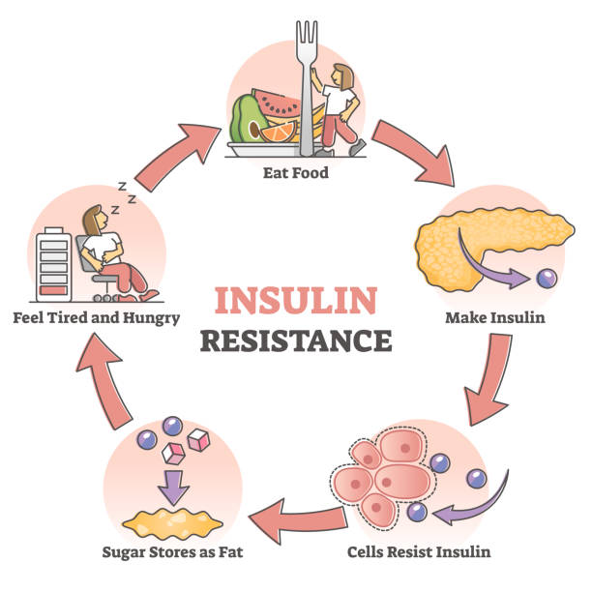
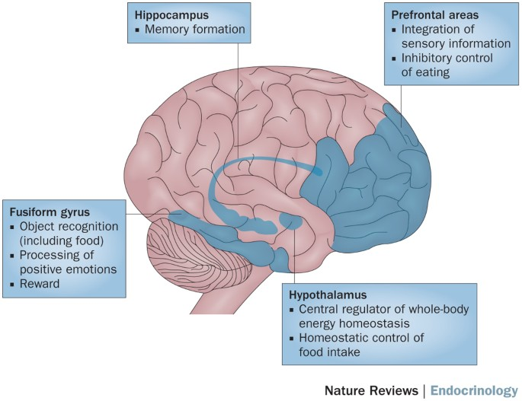
Insulin Resistance in the Body vs Brain
Insulin Resistance in the body:
A vicious cycle
Insulin Resistance in the brain:
Disrupts various functions

Slide 9
Research: How Insulin Resistance Shows Up in Early Alzheimer’s Disease
Hippocampal neurogenesis:
Causes cognitive dysfunction, depleting learning and memory functions
Decreased ability to regulate metabolism. Impaired cognition and mood
Impaired
Cognition
Hippocampal synaptic plasticity is what regulates learning and memory. This process is dependent on healthy insulin function
Impaired Learning and Memory
Insulin resistance in the brain
Hippocampal insulin: Dysregulated physiological cognitive processes
Stimulated Tau Production
Increased Tau protein in the brain relates to worsening stages of the disease
Definition: Insulin resistance may be defined as the failure of brain cells to respond to insulin. AD is regarded as diabetes mellitus of the brain.
Reason: Lack of response to insulin may be due to various causes, including downregulation of insulin receptors, the inability of IR to bind insulin or an impairment of the insulin cascade
Anti Diabetic and Hormonal Therapies have a known progressive effect on patients with AD
Notes:
Hippocampal Neurogenesis: activity dependent process that regulates memory and learning

Slide 10
Neuroinflammation WP-4919
Impacts the Brain: Involves immune activation within the CNS due to injury, infection, toxins, or diseases.
Chronic Neuroinflammation: Linked to conditions like Alzheimer’s, Parkinson’s, and Multiple Sclerosis.
Key Immune Cells Involved:
Consequences of Chronic Neuroinflammation
Microglia Activation
Dual Role: Defend against pathogens and clear debris but can become harmful when chronically activated.
In Disease: Release proinflammatory molecules, leading to neuronal damage, synaptic disruption, and protein accumulation (e.g., amyloid-beta in Alzheimer's).
Astrocytes in Neuroinflammation
Reactive Astrogliosis: Structural and functional changes in response to neuroinflammatory signals.
Impact: Contributes to neuronal injury and worsens the inflammatory environment.
Pro-inflammatory Cytokines: Released by activated microglia and astrocytes.
Neurotoxic Environment: Accelerates neuronal death and disease progression.
Moderate Alzheimer’s patients had 2 differentially expressed genes in this pathway (p-value: 0.0044)
JUN and MTOR - play crucial roles in exacerbating inflammation in the brain
Notes:
JUN Activation
Responds to stress signals, including oxidative stress and cytokines (pro-inflammatory molecules).
Activation of JUN contributes to the inflammatory response in the brain.
Impact: Increased neuronal damage, particularly in neurodegenerative diseases like Alzheimer's.
MTOR Signaling
Involved in key brain functions such as synaptic plasticity and memory formation.
Dysregulation in Neuroinflammation: Overactive mTOR signaling can promote neuroinflammatory processes.
Impact: Enhanced release of pro-inflammatory cytokines, creating environments that support cell damage and loss of function, contributing to neurodegeneration.

Slide 11
Mitochondrial Protein Import Pathway (R-HSA-1268020)
Normal Function:
Gene Alterations: (0.014 p-value, 3/65 overlap)
Transports essential proteins from cytosol into mitochondria to maintain cellular energy
Key functions:
ATP Production: Provides proteins necessary for the electron transport chain, enabling efficient ATP generation.
Oxidative Phosphorylation: Essential for coupling ATP production with oxygen consumption, a key process for high-energy organs like the brain.
Regulation of Apoptosis: Ensures cell survival by regulating proteins involved in programmed cell death.
CHCHD10
Supports mitochondrial structure and cristae stability, indirectly influencing protein import efficiency.
ACO2
encodes aconitase 2
Crucial in the TCA cycle to produce cellular energy, essential for sustaining mitochondrial processes.
HSPD1 (Hsp60)
Acts as a mitochondrial chaperone, fold into their correct three-dimensional shapes, ensuring they are functional stability
Notes:
Key steps: TOM and TIM
Translocation (enter mitochondria)
Sorting and Processing (directed to correct component of mitochondria)
Folding and Assembly (folded into mitochondrial pathway)
Supports atp production, metabolism, cell survival
P Value: 0.014
Found in Reactome 2022 database sheet

Slide 12
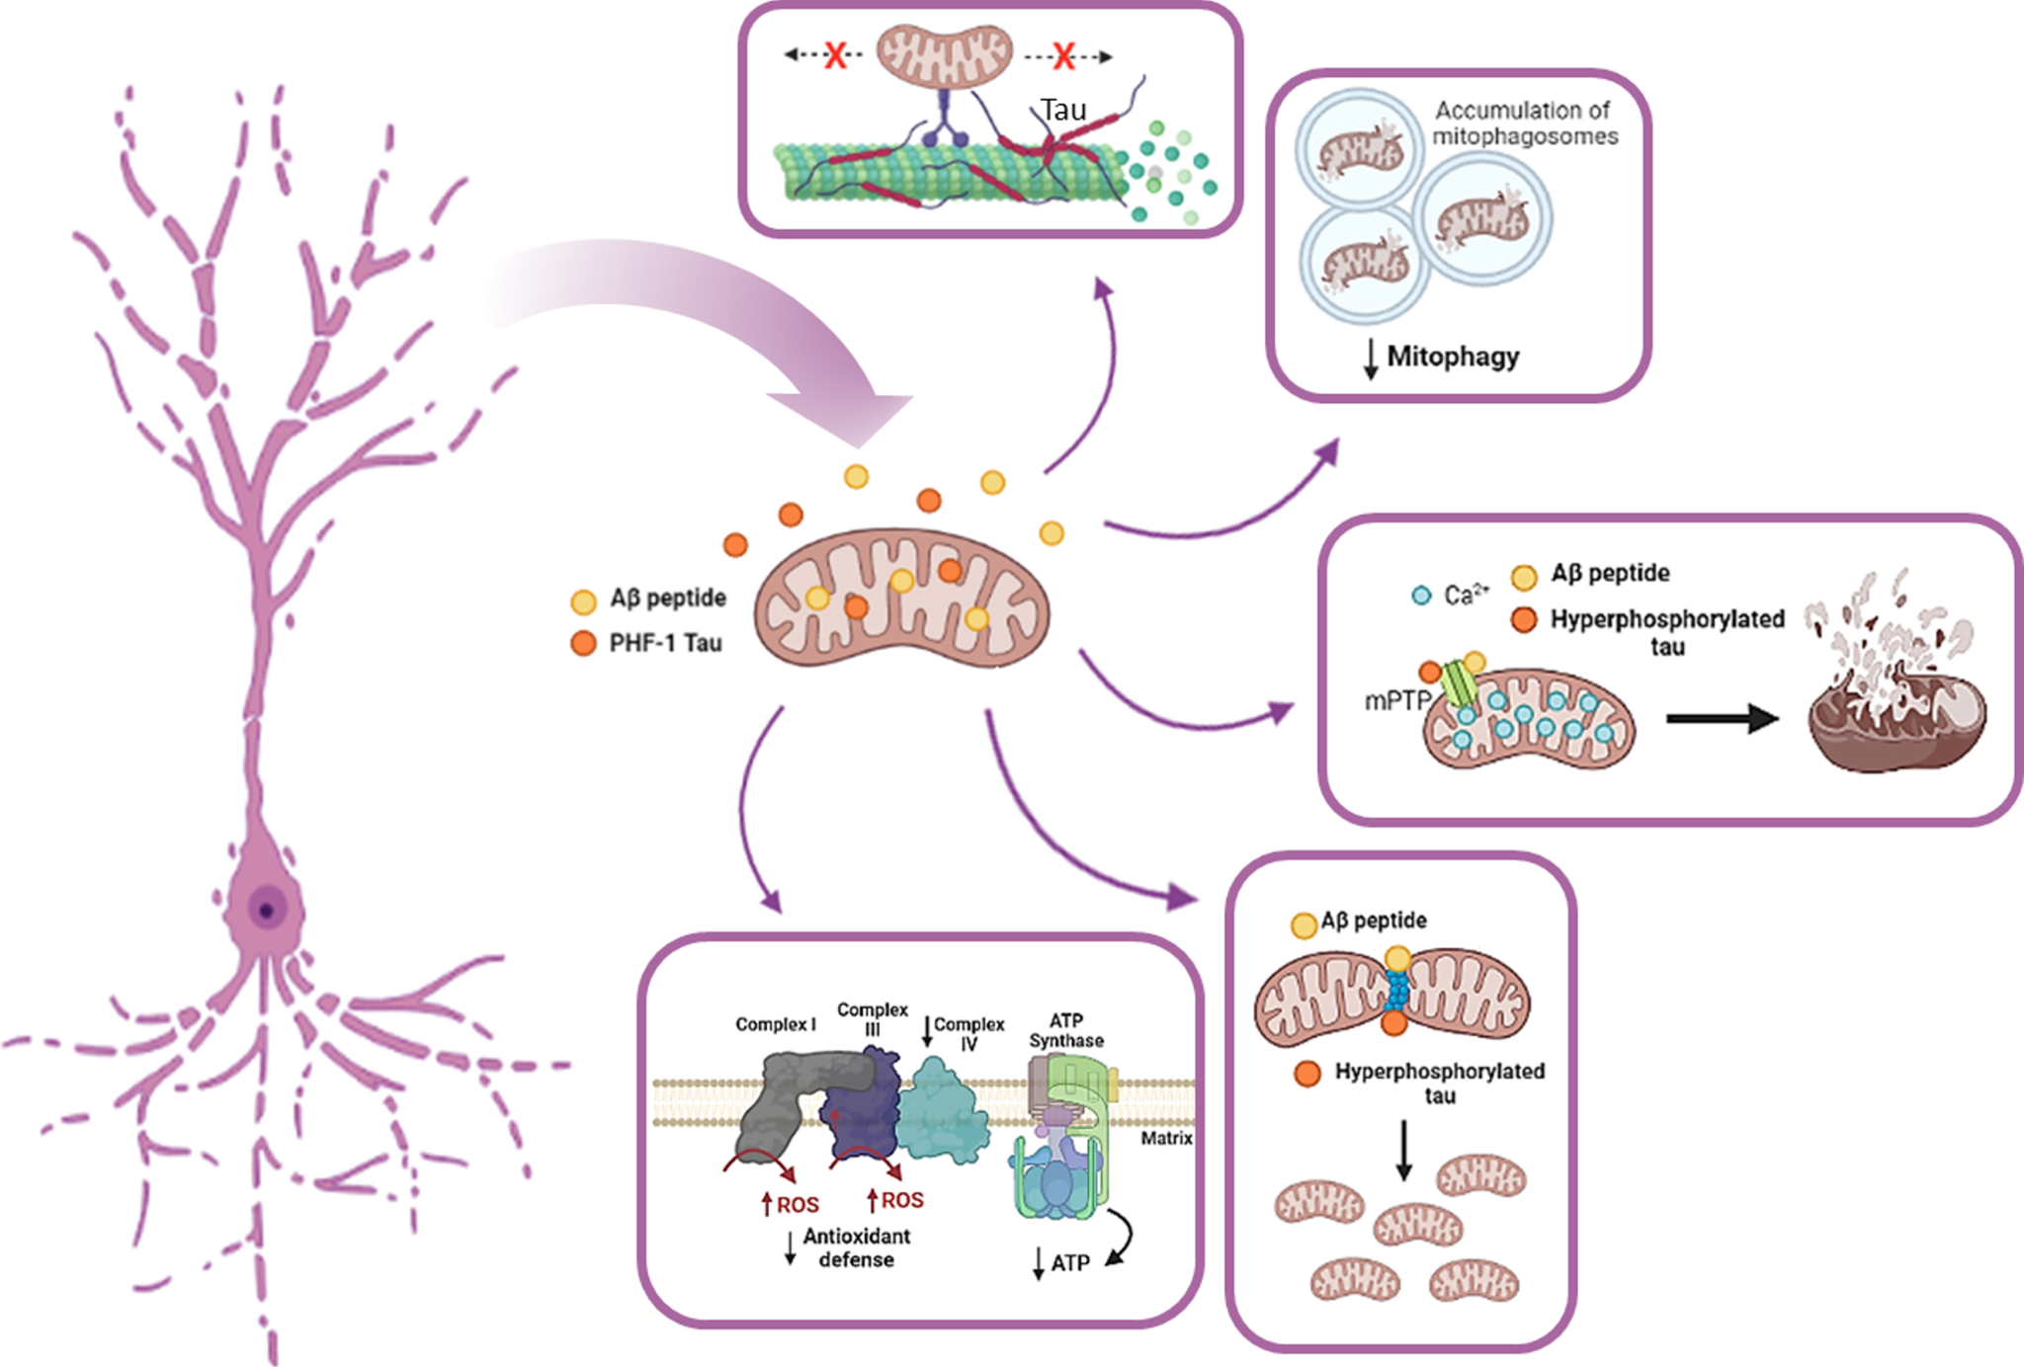
Mitochondrial Protein Import Pathway (R-HSA-1268020)
Energy Deficits:
Disrupted import reduces ATP production
neuron energy shortages
Oxidative Stress:
inefficient import raises free radical levels
Mitochondrial Instability:
Dysfunction weakens mitochondria
neurodegeneration
Neuron Loss:
Impaired import triggers apoptosis
Associated with loss of grey matter in AD
Biomarker Potential:
Mitochondrial genes may help in AD detection and treatment

Slide 13
Severe vs. Moderate

Slide 14
Estrogen Receptor Pathway
This pathway was already discussed and significant results were found in both comparison analyses.
Both p values were less than 0.001
Meaning as AD progresses, estrogen receptor pathways continually decline in function.
2 differentially expressed genes in this pathway: ACOX1 (breaks down fatty acids in brain) and CYP1B1 (regulates homeostasis in brain)
Both have a negative fold change
Could this be pertinent to treatment options?
Estrogen therapy has been proposed as a potential treatment for AD, but is still in the early stages of research
Effectiveness has been shown to vary greatly across patient groups
Factors that influence effectiveness could be age, smoking status, and history of breast cancer
The overall conclusion is estrogen may have an important preventative effect against AD but is less effective as a treatment once the disease has progressed

Slide 15
Insulin Resistance in Patients with Severe AD - Let’s revisit
So IR manifests in more complex ways here
Comparing Severe vs Moderate Groups
We see 17 occurrences of different pathways that regulate insulin production, secretion and resistance
3 of those with p-values < 0.05
Most pathways highlight the insulin release controlled by glucagon-like peptide-1 in intestines
Comparing Moderate vs Incipient Groups
Insulin resistance is a significant pathway with
0.01 p-value
4/108 overlap
Linked Genes:
SLC27A6 | PPARA | PRKAG3 | MTOR
Linked Genes:
PRKAR2A | RAPGEF4 | DOK1

Slide 16
Insulin Behaviour in Patients with Severe AD
Not enough research: Insulin Resistance is a risk factor typically associated with early stages of Alzheimers
Reduced Brain Glucose Metabolism
Increased Tau production
Neuroinflammation
Oxidative Stress
Glucose Metabolism Dysregulation gradually intensifies the severity of AD
Insulin resistance disrupts glucose metabolism in AD.
Creates an “energy crisis” in neurons.
Accelerates cognitive decline.
Insulin Resistance Stimulates Tau Protein Production
Decreased insulin signaling in the brain leads to tau hyperphosphorylation.
Contributes to worsening AD pathology.
Chronic insulin resistance promotes inflammation
Brain inflammation disrupts cellular communication.
Weakens the blood-brain barrier.
Accelerates neuronal loss and cognitive decline in advanced AD stages.
Insulin resistance can exacerbate oxidative stress
Insulin resistance raises oxidative stress in the brain.
Increases neuron vulnerability to damage.
Speeds up progression of AD symptoms.

Slide 17
Regulation Of I-kappaB kinase/NF-kappaB Signaling
Related to the neuroinflammation pathway
Significant results found in both comparison analyses (p-value: 0.00043)
Key Genes Involved
Therapeutic Strategy
Goal
PER1, TRAF4, CLEC7A, LPAR1, REL, MUL1, CFLAR, TMEM106A, LTF
Anti-Inflammatory Drugs: Reduce inflammation to protect neurons.
Cytokine Inhibition: Inhibit specific pro-inflammatory cytokines to slow down disease progression.
Modulating Immune Response: Adjust microglial and astrocytic activity to limit neurotoxicity.
To slow Alzheimer's progression by reducing neuroinflammation and protecting neurons from further damage.
Significance in Alzheimer's Progression:
Chronic Inflammation: Linked to cognitive decline and worsening of symptoms.

Slide 18
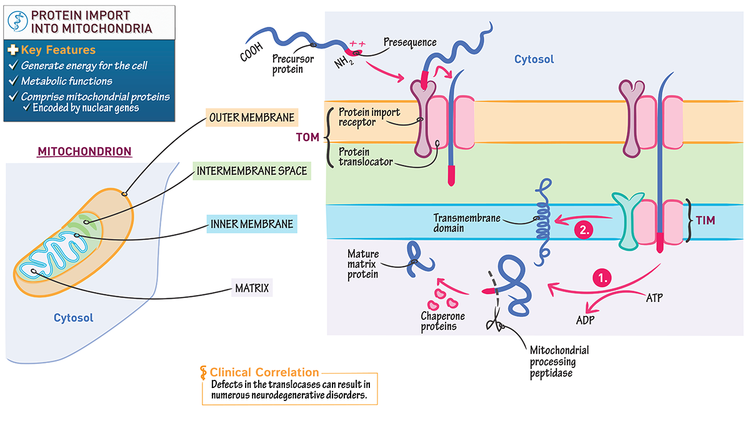
Mitochondrial Protein Import Pathway (R-HSA-1268020)
Gene Alterations: (0.024 p-value, 3/65 overlap)
COQ2
Involved in coenzyme Q10 biosynthesis, essential for mitochondrial electron transport and ATP production.
TIMM17A
Part of the TIM complex, facilitates protein import into the mitochondrial matrix, supporting energy metabolism.
TOMM22
A core component of the TOM complex, responsible for recognizing and translocating proteins into mitochondria.
Notes:
Seem to be less significant in the moderate vs severe then incipient vs mod
P value 0.024961262781567
Adds up with the known progression of mitochondrial dsyfunction
• Gene Editing: Use CRISPR to correct mitochondrial DNA mutations.
• Replacement Therapy: Develop mitochondrial replacement techniques.
• Targeted Drugs: Design mitochondria-specific drug delivery systems.
• Biogenesis Boost: Stimulate new mitochondria production.
• Protein Import Study: Explore TIM and TOM pathways in disease.
• Oxidative Stress Control: Find effective antioxidants for mitochondria.
• Quality Control: Enhance mitophagy and mitochondrial dynamics.
• Biomarker Discovery: Identify biomarkers for diagnosis and tracking.
• Stem Cell Potential: Test stem cells for mitochondrial repair.
• Aging Studies: Investigate mitochondrial decline with age.

Slide 19
Questions?

Slide 20
References

Slide 21
References
Ali N, Sohail R, Jaffer SR, Siddique S, Kaya B, Atowoju I, Imran A, Wright W, Pamulapati S, Choudhry F, Akbar A, Khawaja UA. The Role of Estrogen Therapy as a Protective Factor for Alzheimer's Disease and Dementia in Postmenopausal Women: A Comprehensive Review of the Literature. Cureus. 2023 Aug 6;15(8):e43053. doi: 10.7759/cureus.43053. PMID: 37680393; PMCID: PMC10480684.
Cipriano GL, Mazzon E, Anchesi I. Estrogen Receptors: A New Frontier in Alzheimer's Disease Therapy. Int J Mol Sci. 2024 Aug 21;25(16):9077. doi: 10.3390/ijms25169077. PMID: 39201762; PMCID: PMC11354998.
Heneka MT, Carson MJ, El Khoury J, Landreth GE, Brosseron F, Feinstein DL, Jacobs AH, Wyss-Coray T, Vitorica J, Ransohoff RM, Herrup K, Frautschy SA, Finsen B, Brown GC, Verkhratsky A, Yamanaka K, Koistinaho J, Latz E, Halle A, Petzold GC, Town T, Morgan D, Shinohara ML, Perry VH, Holmes C, Bazan NG, Brooks DJ, Hunot S, Joseph B, Deigendesch N, Garaschuk O, Boddeke E, Dinarello CA, Breitner JC, Cole GM, Golenbock DT, Kummer MP. Neuroinflammation in Alzheimer's disease. Lancet Neurol. 2015 Apr;14(4):388-405. doi: 10.1016/S1474-4422(15)70016-5. PMID: 25792098; PMCID: PMC5909703.
Nassief A, Zambon AC, Narayan N, Palakal M. Mitochondrial Protein Import Dysfunction in Pathogenesis of Neurodegenerative Diseases. Front Cell Dev Biol. 2020;8:1329. doi: 10.3389/fcell.2020.613464. PMID: 33180216; PMCID: PMC7691489.
Sędzikowska A, Szablewski L. Insulin and Insulin Resistance in Alzheimer's Disease. Int J Mol Sci. 2021 Sep 15;22(18):9987. doi: 10.3390/ijms22189987. PMID: 34576151; PMCID: PMC8472298.
Sun Y, Koyama Y, Shimada S. Inflammation From Peripheral Organs to the Brain: How Does Systemic Inflammation Cause Neuroinflammation? Front Aging Neurosci. 2022 Jun 16;14:903455. doi: 10.3389/fnagi.2022.903455. PMID: 35783147; PMCID: PMC9244793.
Tilley DM, Vallejo R, Vetri F, Platt DC, Cedeno DL. Activation of Neuroinflammation via mTOR Pathway is Disparately Regulated by Differential Target Multiplexed and Traditional Low-Rate Spinal Cord Stimulation in a Neuropathic Pain Model. J Pain Res. 2022 Sep 13;15:2857-2866. doi: 10.2147/JPR.S378490. PMID: 36156899; PMCID: PMC9507284.
Zhu D, Montagne A, Zhao Z. Alzheimer's pathogenic mechanisms and underlying sex difference. Cell Mol Life Sci. 2021 Jun;78(11):4907-4920. doi: 10.1007/s00018-021-03830-w. Epub 2021 Apr 12. PMID: 33844047; PMCID: PMC8720296.

Slide 22
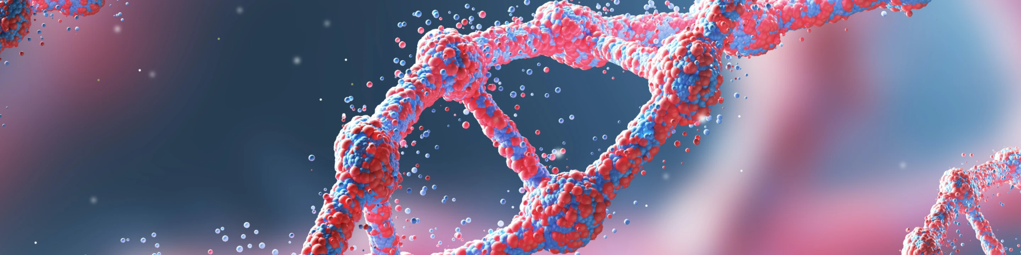
Thank you. We look forward to your feedback and comments.
Notes:
Can we identify risk?

